Slide 1
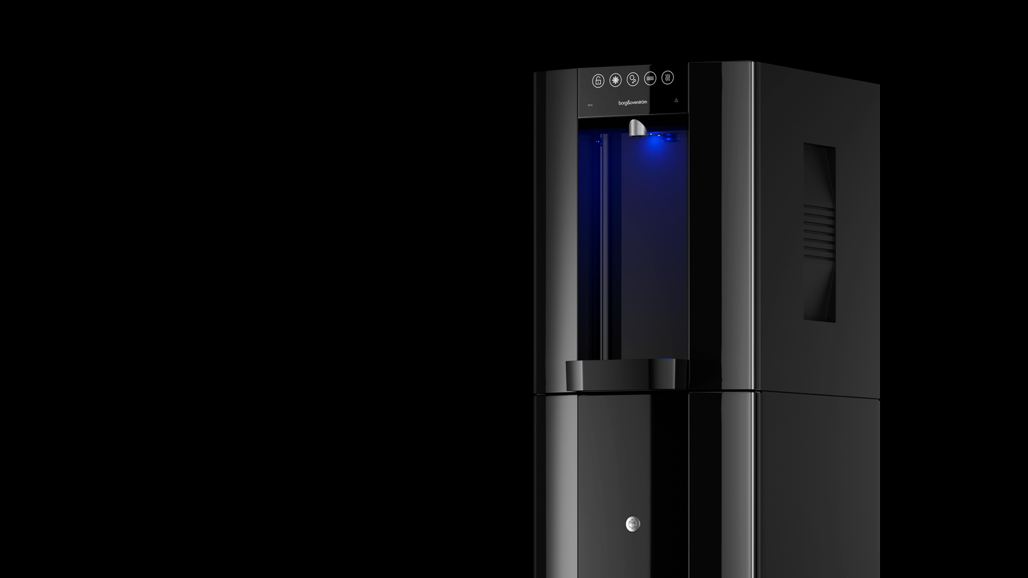




Product Maintenance
& Support
E6 Product Maintenance & Support | Training Deck to HMI Issue 9 & Main Control Issue 10 (HW V1.1) and Issue 12 (HW V2.1)
Issue 1 - 17062024

Slide 2
Contents
Back Panel
Specification Label
Water Pathway
HMI/Lens
Specifications
Main Control Board
Features
Service Codes
Installation
E6 Product Maintenance & Support | Training Deck to HMI Issue 9 & Main Control Issue 10 (HW V1.1) and Issue 12 (HW V2.1)
Issue 1 - 17062024

Slide 3
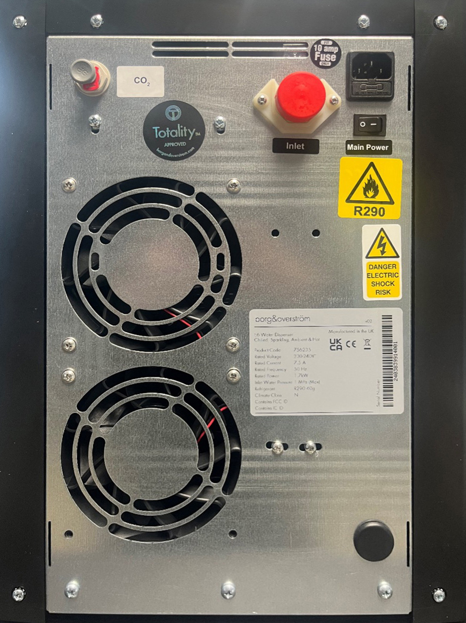
Back Panel
IEC socket with internal 10a fuse
Co₂ Inlet – ¼”
PF Connector
On/Off switch for operation of unit
Water Inlet – ¾” Male BSP Connector
Specification Label
Cooling Fan (24vdc)
Access hole for SensorBeam wiring loom (additional accessory)
E6 Product Maintenance & Support | Training Deck to HMI Issue 9 & Main Control Issue 10 (HW V1.1) and Issue 12 (HW V2.1)
Issue 1 - 17062024

Slide 4
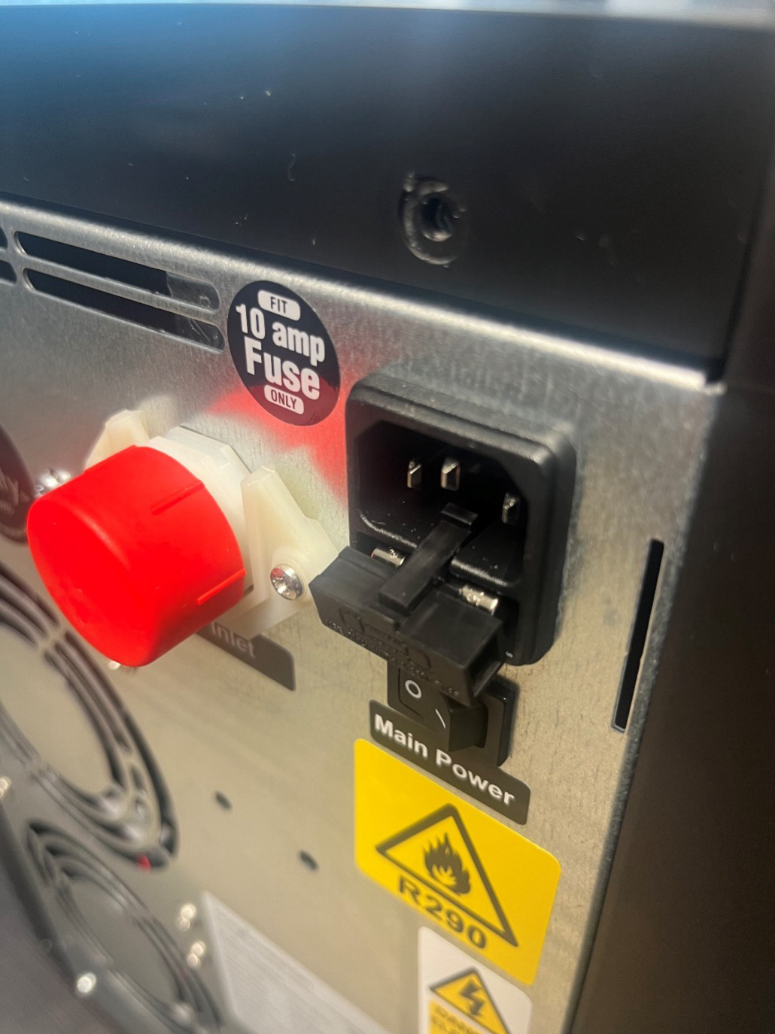
IEC Fuse
10a IEC Fuse
E6 Product Maintenance & Support | Training Deck to HMI Issue 9 & Main Control Issue 10 (HW V1.1) and Issue 12 (HW V2.1)
Issue 1 - 17062024

Slide 5
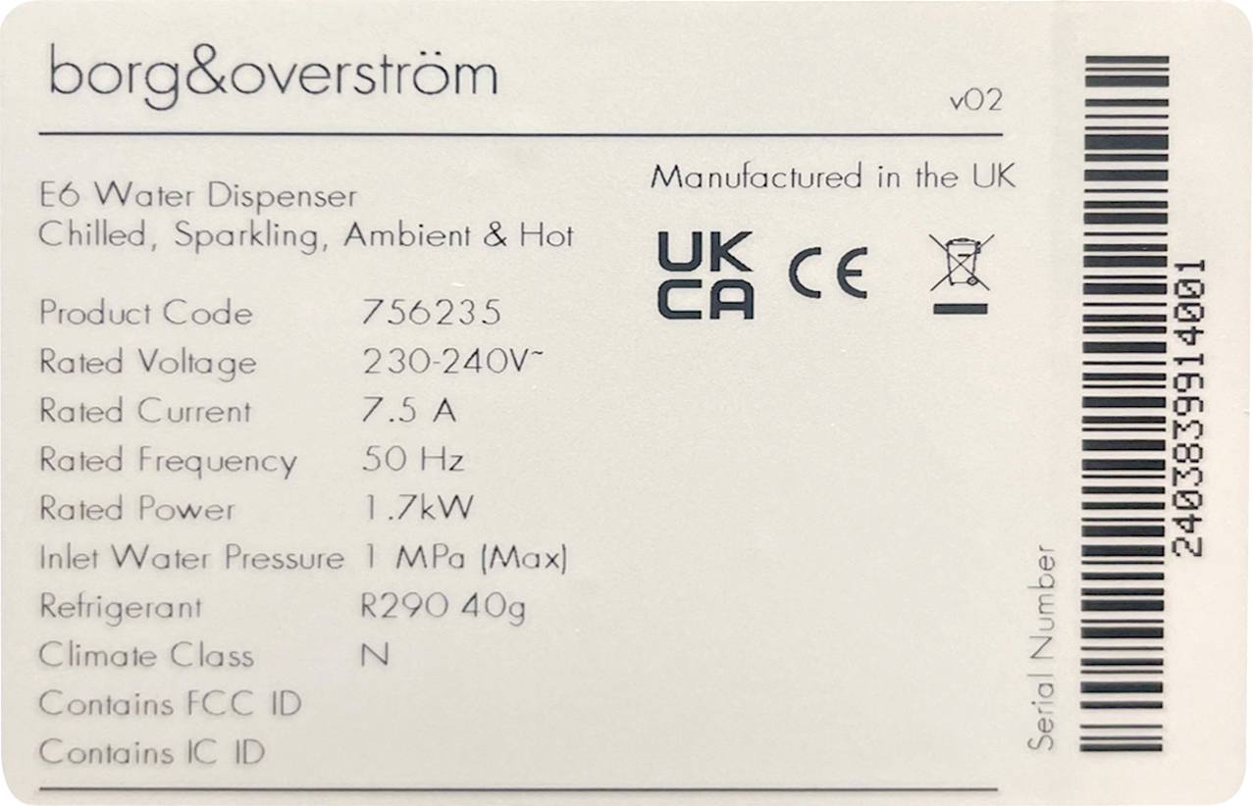
Specification Label
Serial Number:
2403 839914 001
2403: Year and Month Unit Manufactured (March 2024).
839914: Works Order on when
unit was manufactured for
traceability of parts used.
001: Unique number for multiple
units built on same Works Order.
E6 Product Maintenance & Support | Training Deck to HMI Issue 9 & Main Control Issue 10 (HW V1.1) and Issue 12 (HW V2.1)
Issue 1 - 17062024

Slide 6
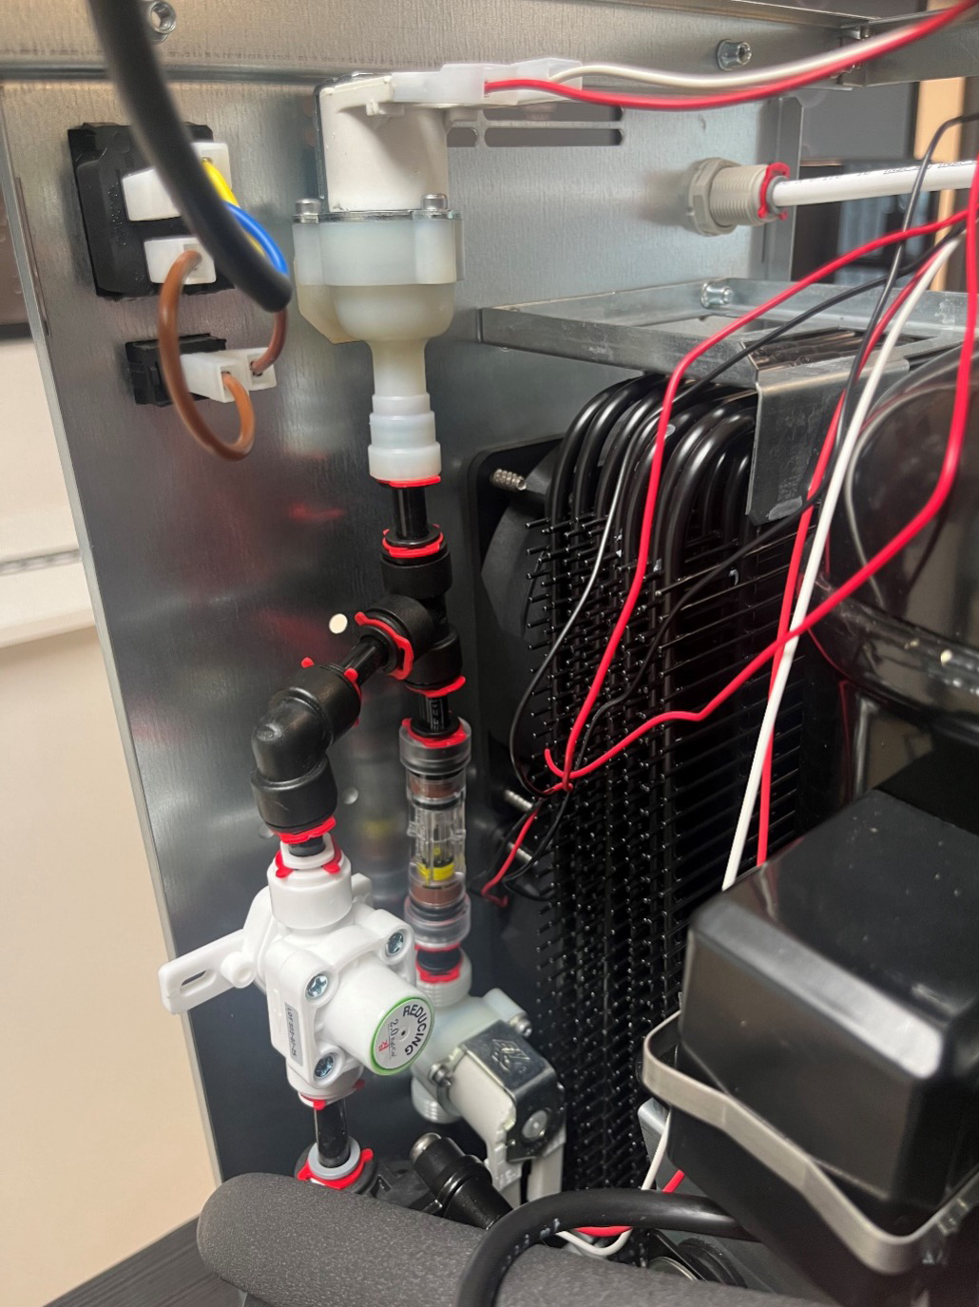
Water Pathway
Water Inlet Valve (3/4” Male BSP)
Hot SCV & Flow Controller set to 1.9l pm
PRV Preset to 2bar
Hot Solenoid Valve (Pre-Hot Tank)
E6 Product Maintenance & Support | Training Deck to HMI Issue 9 & Main Control Issue 10 (HW V1.1) and Issue 12 (HW V2.1)
Issue 1 - 17062024

Slide 7
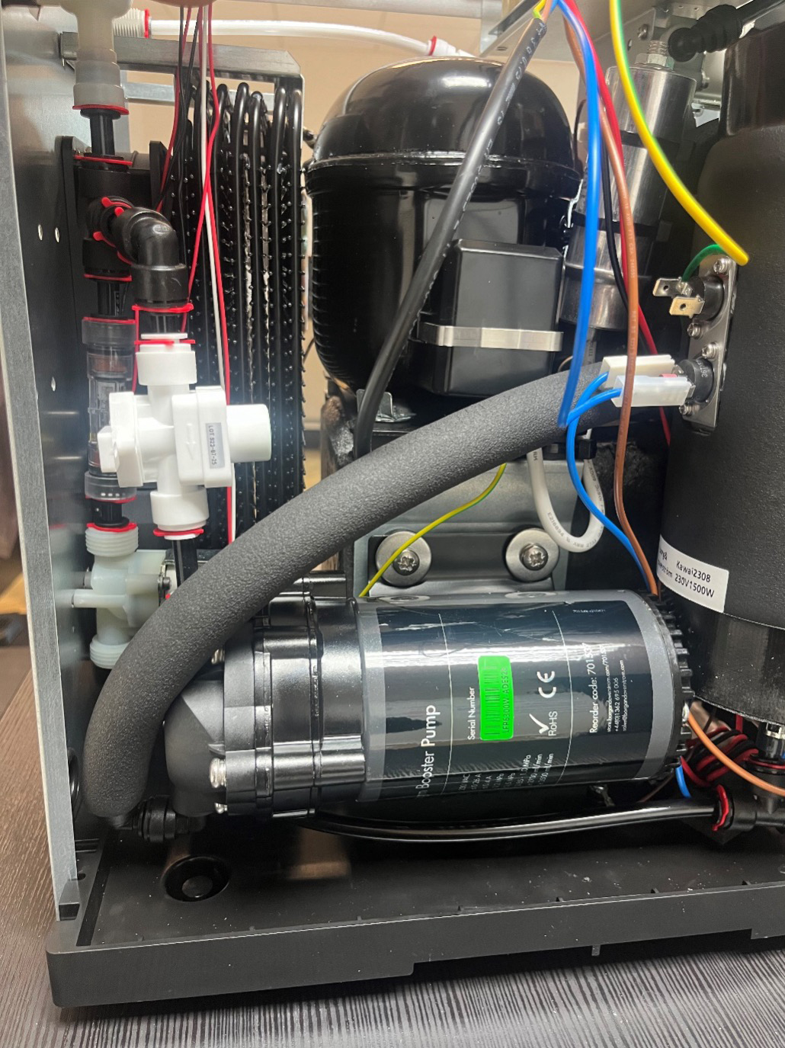
Water Pathway
Water feed from PRV 2bar to Carbonation Pump
Outlet of Carbonation Pump to Feed Ambient & Dry Block water lines.
Note: Pump will only be energised when refilling of carbonation tank only.
E6 Product Maintenance & Support | Training Deck to HMI Issue 9 & Main Control Issue 10 (HW V1.1) and Issue 12 (HW V2.1)
Issue 1 - 17062024

Slide 8
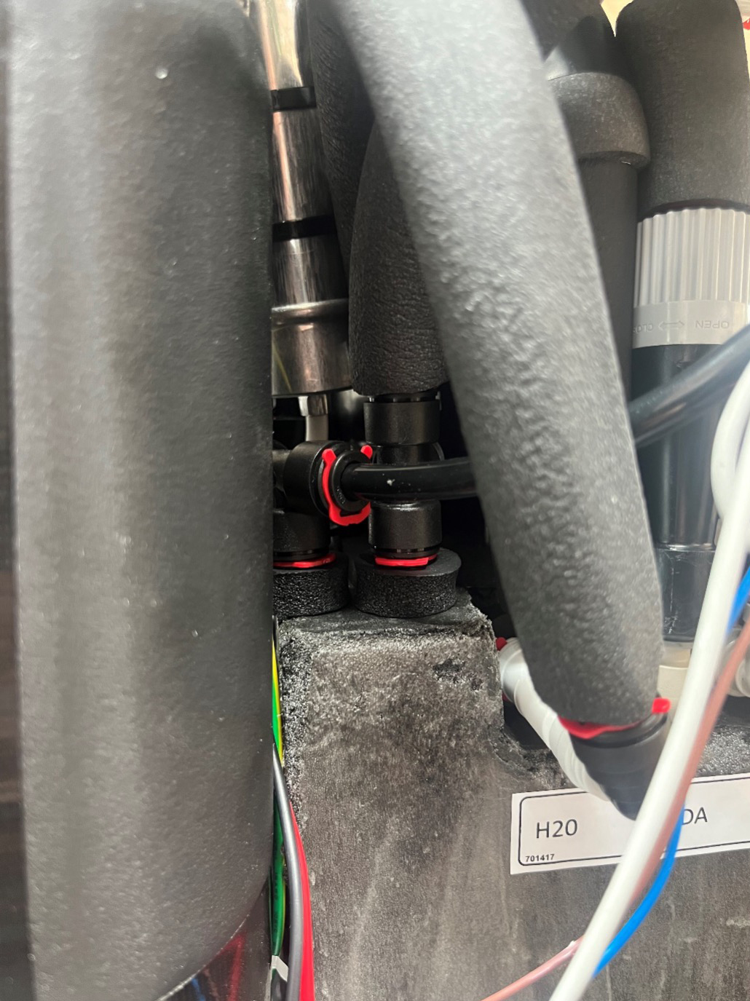
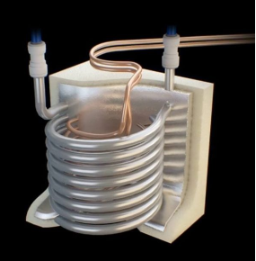
Water Pathway
Water exiting Dry Block as Chilled water.
Chilled water feed to Chilled Solenoid.
Chilled water feed to Inlet of Carbonation Tank.
Water feed from Carbonation Pump to 8mm Tee – Enters Dry Block as Ambient temperature.
Ambient Dispense to Ambient Dispense Solenoid (uninsulated)
E6 Product Maintenance & Support | Training Deck to HMI Issue 9 & Main Control Issue 10 (HW V1.1) and Issue 12 (HW V2.1)
Issue 1 - 17062024

Slide 9
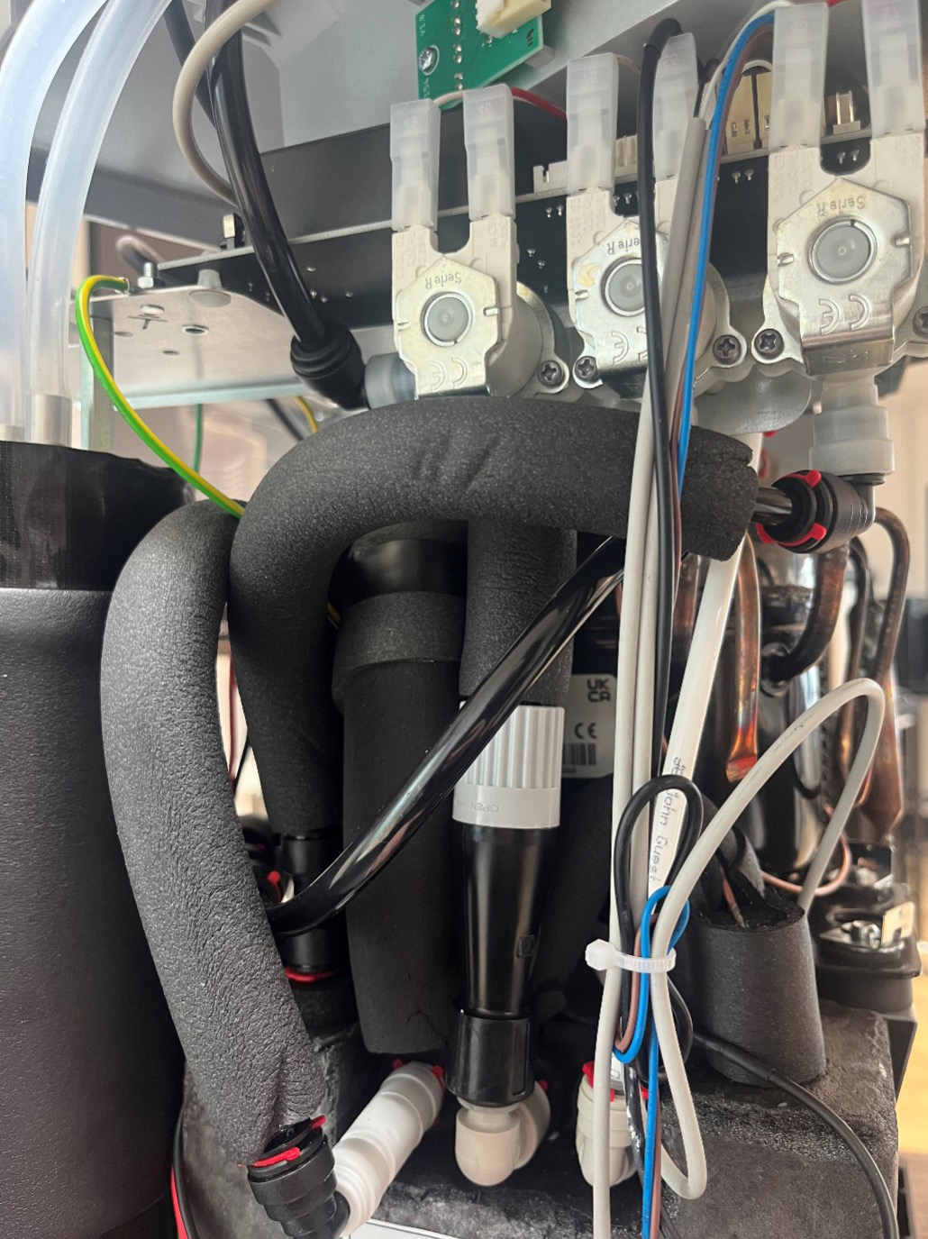
Water Pathway
Co₂ Gas Inlet
Sparkling Dispense
Adjustable Sparkling
Flow Controller
(Clockwise = Closing
Anti Clockwise = Opening)
Chilled water feed to Inlet of Carbonation Tank
E6 Product Maintenance & Support | Training Deck to HMI Issue 9 & Main Control Issue 10 (HW V1.1) and Issue 12 (HW V2.1)
Issue 1 - 17062024

Slide 10
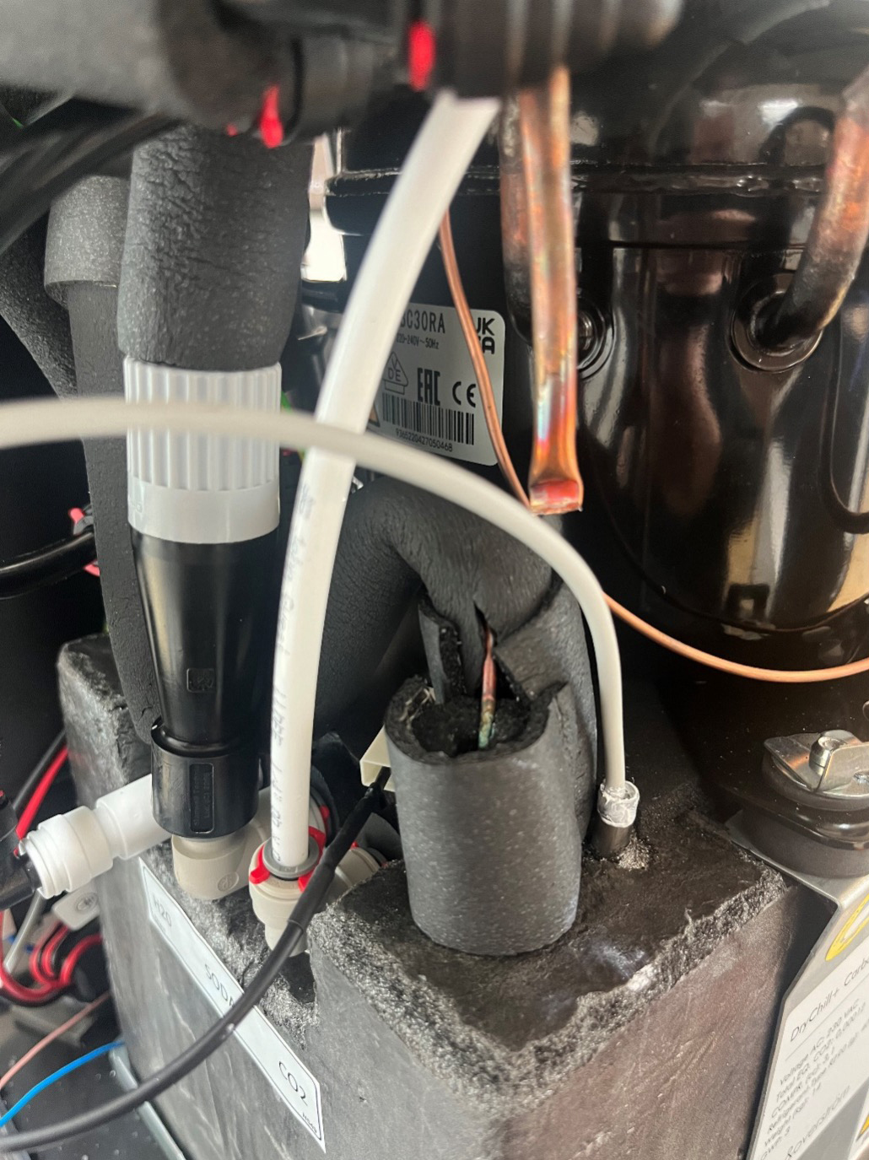
Water Pathway
Carb Tank Level Probe
Dry Block NTC Thermistor Probe
E6 Product Maintenance & Support | Training Deck to HMI Issue 9 & Main Control Issue 10 (HW V1.1) and Issue 12 (HW V2.1)
Issue 1 - 17062024

Slide 11
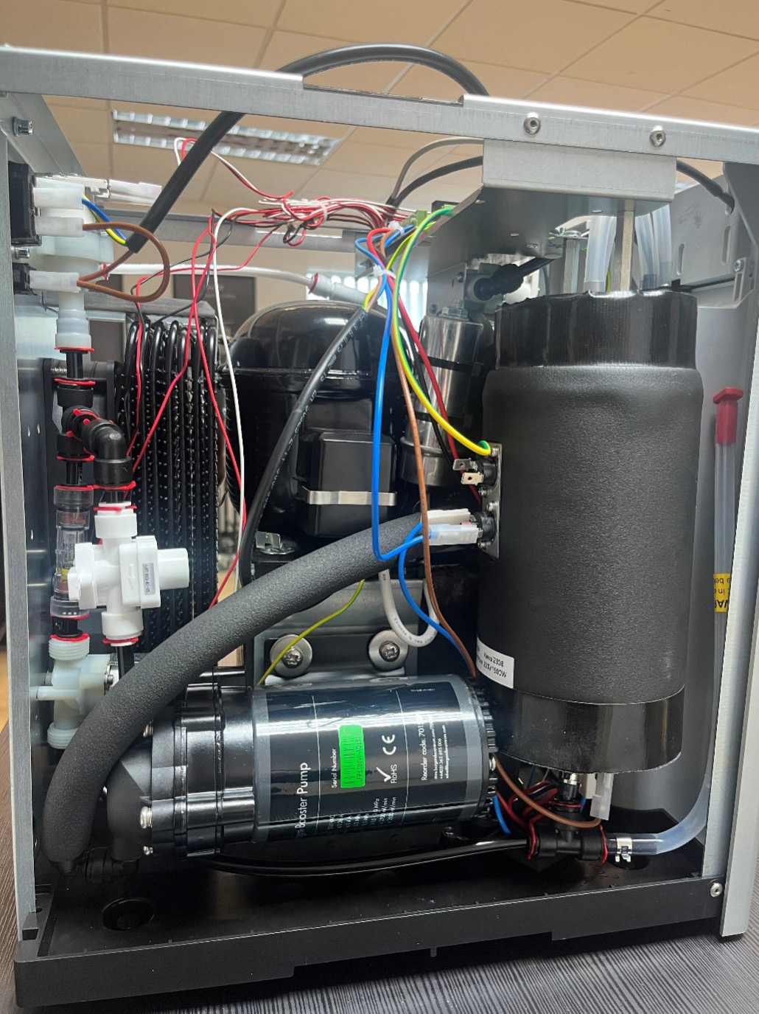
Water Pathway
Hot Tank Safety Cut-Out Sensor – 105c
Hot Solenoid
Water Feed to Hot Tank Inlet (bottom of Hot Tank) from Hot Solenoid
Hot Tank Drain
Note: Unit must be decommissioned before draining Hot Tank
E6 Product Maintenance & Support | Training Deck to HMI Issue 9 & Main Control Issue 10 (HW V1.1) and Issue 12 (HW V2.1)
Issue 1 - 17062024

Slide 12
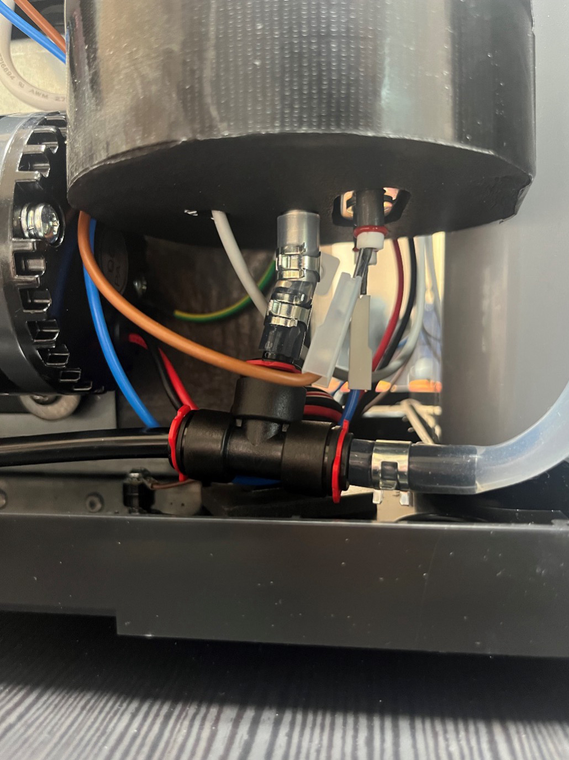
Water Pathway
Hot Tank Thermistor Probe
E6 Product Maintenance & Support | Training Deck to HMI Issue 9 & Main Control Issue 10 (HW V1.1) and Issue 12 (HW V2.1)
Issue 1 - 17062024

Slide 13
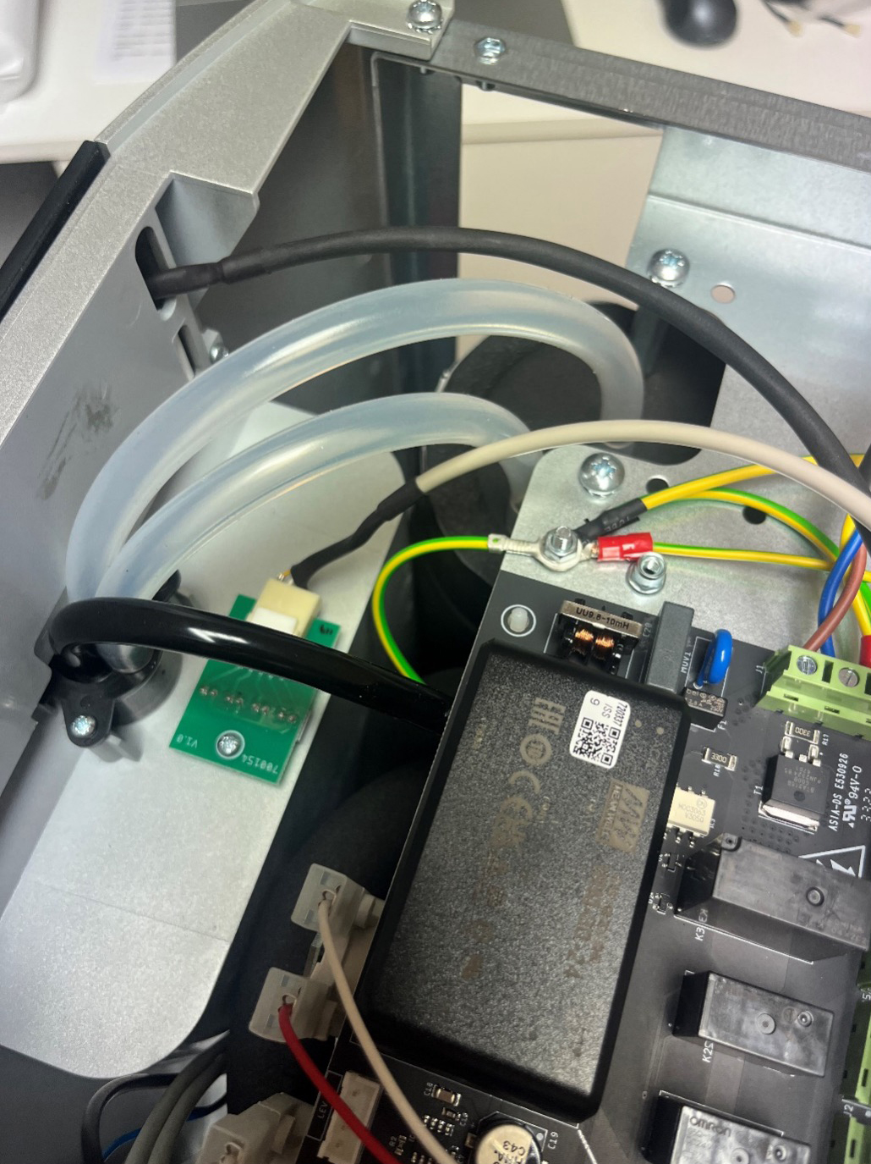
Water Pathway
Hot Tank Dispense Pipe
Hot Tank Vent Pipe
Chilled, Sparkling & Ambient common dispense pipe from
3-way Solenoid Bankment
E6 Product Maintenance & Support | Training Deck to HMI Issue 9 & Main Control Issue 10 (HW V1.1) and Issue 12 (HW V2.1)
Issue 1 - 17062024

Slide 14








HMI/Lens
E6 Product Maintenance & Support | Training Deck to HMI Issue 9 & Main Control Issue 10 (HW V1.1) and Issue 12 (HW V2.1)
Issue 1 - 17062024

Slide 15
HMI/Lens
Hot Unlock Icon – Commissioning/Decommissioning
On Hot Models, the engineer will need to fill up the Hot Tank by touching the Hot Unlock Icon and then the Hot Dispense Icon until water comes from the Hot option. Once water has come from the Hot option, the unit can then be commissioned by holding the Hot Unlock Icon only for up to 20secs and then the complete unit will start up.
If the Hot Unlock and Hot Icon flashing simultaneously, this indicates the unit has not been commissioned yet, therefore all AC components inactive.
E6 Product Maintenance & Support | Training Deck to HMI Issue 9 & Main Control Issue 10 (HW V1.1) and Issue 12 (HW V2.1)
Issue 1 - 17062024

Slide 16
HMI/Lens
Chilled Icon
If slowly pulsating, this indicates the Dry Block temperature is above 10c. If solid, this indicates the temperature in the Dry block is below 10c.
If the Chilled Icon completely off and the Red Warning triangle is solid, this indicates the Chiller NTC probe is damaged or not connected to the MC Board.
To turn Eco Off – Chilled button 7 times and one audible beep
To turn Eco on – Chilled button 7 times and two audible beeps
Turn BT off – Chilled button 5 times and one audible beep
Turn BT on – Chilled button 5 times and two audible beeps
Turn BT App – Chilled button 10 times and one audible beep
Turn BT App – Chilled button 10 times and two audible beeps
E6 Product Maintenance & Support | Training Deck to HMI Issue 9 & Main Control Issue 10 (HW V1.1) and Issue 12 (HW V2.1)
Issue 1 - 17062024

Slide 17
HMI/Lens
Sparkling Icon
If the Sparkling Icon completely off and the Red Warning triangle is solid, this indicates the Carb tank level sensor is damaged or not connected to the MC Board.
E6 Product Maintenance & Support | Training Deck to HMI Issue 9 & Main Control Issue 10 (HW V1.1) and Issue 12 (HW V2.1)
Issue 1 - 17062024

Slide 18
HMI/Lens
Ambient Icon
The Ambient Icon will always be energised (unless if unit has gone into Eco Mode)
E6 Product Maintenance & Support | Training Deck to HMI Issue 9 & Main Control Issue 10 (HW V1.1) and Issue 12 (HW V2.1)
Issue 1 - 17062024

Slide 19
HMI/Lens
Hot Icon
If slowly pulsating, this indicates the Hot Tank temperature is below 82c. If solid, this indicates the temperature in the Hot Tank is above 82c.
If the Hot Icon completely off and the Red Warning triangle is solid, this indicates the Hot Tank NTC probe is damaged or not connected to the MC Board.
If the Hot Unlock and Hot Icon flashing simultaneously, this indicates the unit has not been commissioned yet, therefore all AC components inactive.
E6 Product Maintenance & Support | Training Deck to HMI Issue 9 & Main Control Issue 10 (HW V1.1) and Issue 12 (HW V2.1)
Issue 1 - 17062024

Slide 20
HMI/Lens
Eco
If Eco Mode is enabled, via 2 hours of inactivity or 7mins of darkness, all dispense icons are off and the Eco light will be energised.
E6 Product Maintenance & Support | Training Deck to HMI Issue 9 & Main Control Issue 10 (HW V1.1) and Issue 12 (HW V2.1)
Issue 1 - 17062024

Slide 21
HMI/Lens
Red Warning Triangle
Red warning triangle will be energised to confirm a specific fault within the unit.
E6 Product Maintenance & Support | Training Deck to HMI Issue 9 & Main Control Issue 10 (HW V1.1) and Issue 12 (HW V2.1)
Issue 1 - 17062024

Slide 22
HMI/Lens
Light Sensor
Light Sensor to detect light/darkness in relation to Eco Mode.
10 Min Window of Unit Start up:
Eco Mode
Commissioning Mode
BT Waste
BT App
Dual Touch
E6 Product Maintenance & Support | Training Deck to HMI Issue 9 & Main Control Issue 10 (HW V1.1) and Issue 12 (HW V2.1)
Issue 1 - 17062024

Slide 23
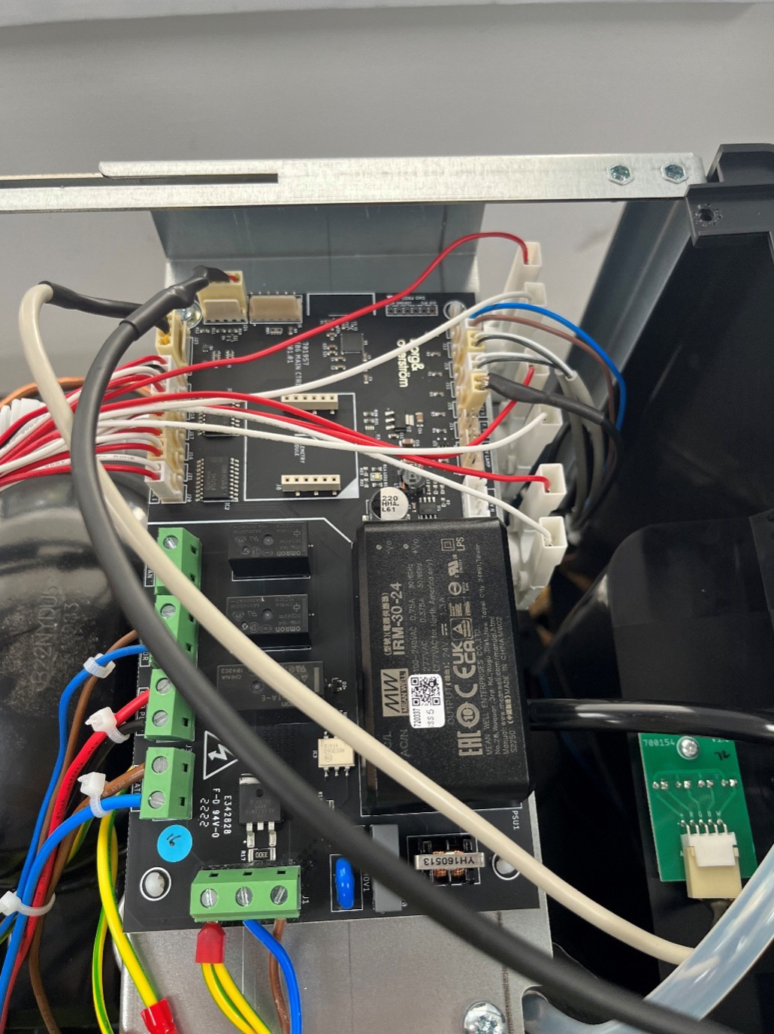
Main Control Board
E6 Product Maintenance & Support | Training Deck to HMI Issue 9 & Main Control Issue 10 (HW V1.1) and Issue 12 (HW V2.1)
Issue 1 - 17062024

Slide 24
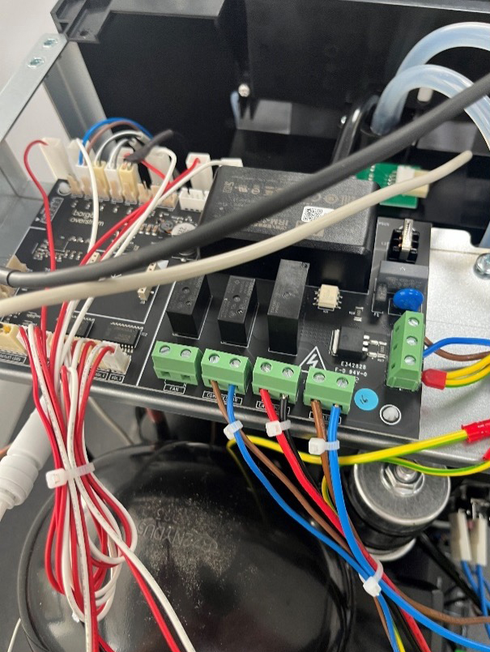
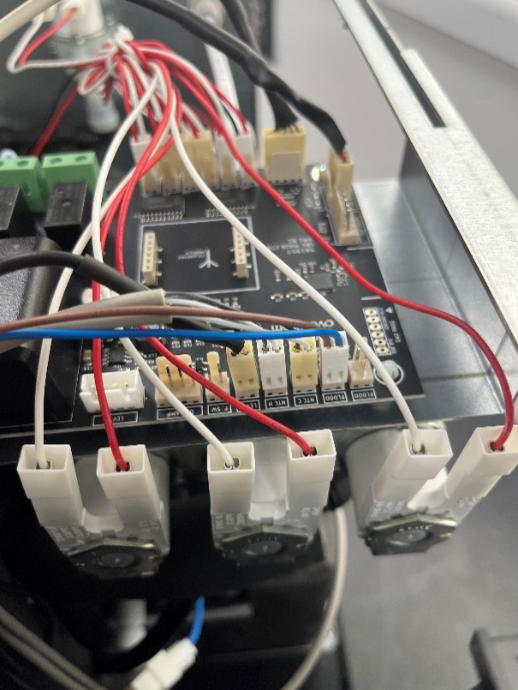
Main Control Board
Mains Power Into
MC Board
Heater
Carb Level Sense
Carb Pump
NTC H
Compressor
NTC C
Fan*
Flood Detection
Main Power Output from
MC Board
Fan* = Not used from V06
Images show HW V1.1
HW V2.1 will have slightly different layout.
E6 Product Maintenance & Support | Training Deck to HMI Issue 9 & Main Control Issue 10 (HW V1.1) and Issue 12 (HW V2.1)
Issue 1 - 17062024

Slide 25
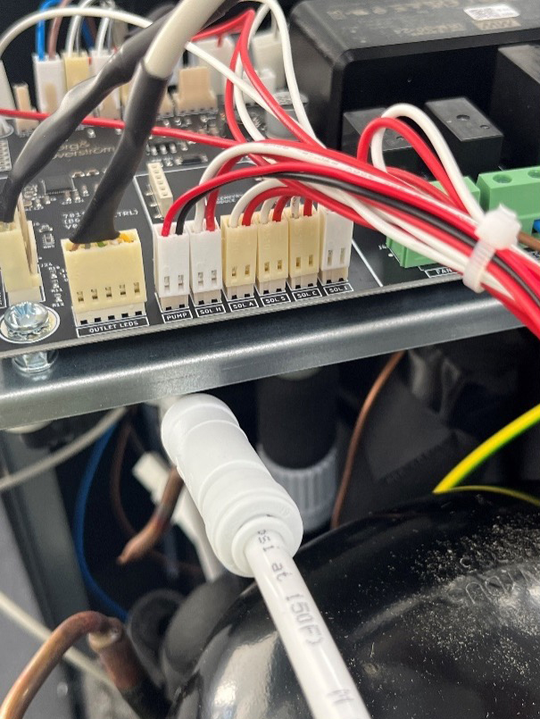
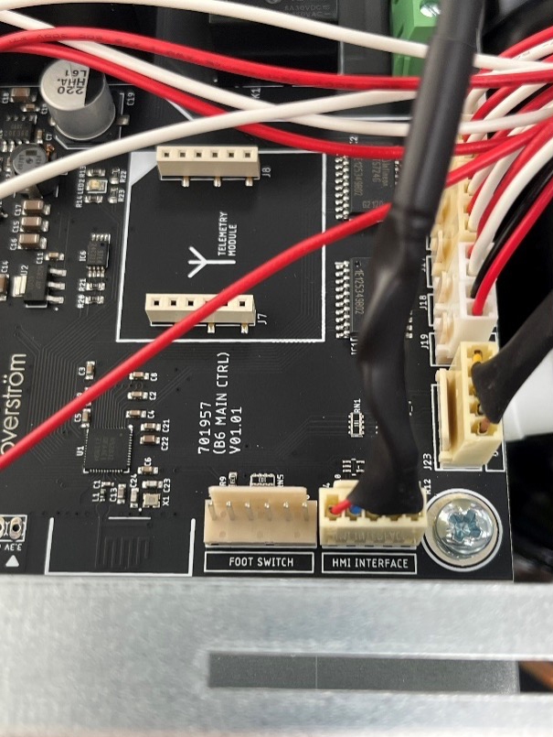
Main Control Board
Inlet Solenoid.
Sparkling Solenoid
Hot Solenoid
Downlight LED’s
Pump = 24vdc Cooling Fan (From Ver06)
Footswitch = SensorBeam
Ambient Solenoid
HMI Interface
Chilled Solenoid
Images show HW V1.1
HW V2.1 will have slightly different layout.
E6 Product Maintenance & Support | Training Deck to HMI Issue 9 & Main Control Issue 10 (HW V1.1) and Issue 12 (HW V2.1)
Issue 1 - 17062024

Slide 26
Specification
E6 Product Maintenance & Support | Training Deck to HMI Issue 9 & Main Control Issue 10 (HW V1.1) and Issue 12 (HW V2.1)
Issue 1 - 17062024

Slide 27
Specification
E6 Product Maintenance & Support | Training Deck to HMI Issue 9 & Main Control Issue 10 (HW V1.1) and Issue 12 (HW V2.1)
Issue 1 - 17062024

Slide 28
Main Control and HMI Features
E6 Product Maintenance & Support | Training Deck to HMI Issue 9 & Main Control Issue 10 (HW V1.1) and Issue 12 (HW V2.1)
Issue 1 - 17062024

Slide 29
Main Control and HMI Features
E6 Product Maintenance & Support | Training Deck to HMI Issue 9 & Main Control Issue 10 (HW V1.1) and Issue 12 (HW V2.1)
Issue 1 - 17062024

Slide 30
Main Control and HMI Features
E6 Product Maintenance & Support | Training Deck to HMI Issue 9 & Main Control Issue 10 (HW V1.1) and Issue 12 (HW V2.1)
Issue 1 - 17062024

Slide 31

Fault Codes
E6 Product Maintenance & Support | Training Deck to HMI Issue 9 & Main Control Issue 10 (HW V1.1) and Issue 12 (HW V2.1)
Issue 1 - 17062024

Slide 32
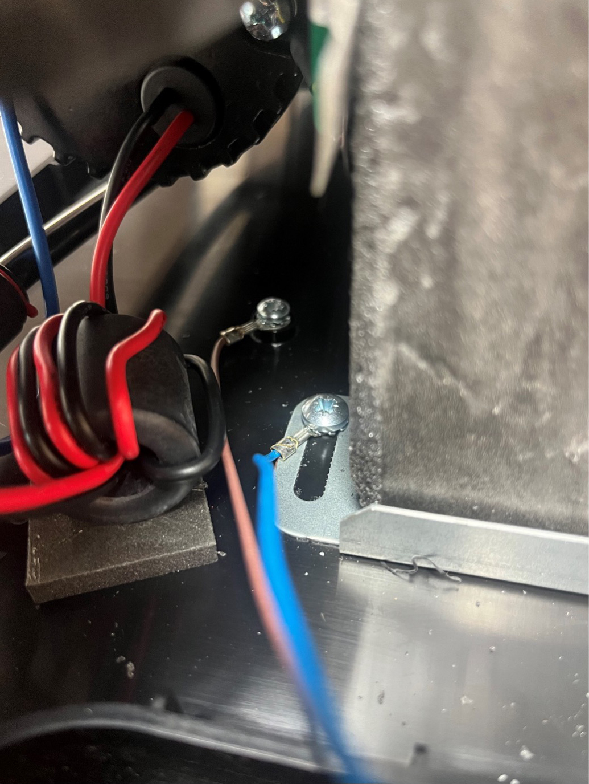
Fault Codes
Internal Leak Sensor – When activated, complete unit shuts
down. Probes located under the carbonation pump.
Internal overheat triggered – When activated, complete unit
shuts down.
Carbonator can not filling – When activated, Sparkling side
only inactive (5mins).
Boiler not heating correctly – When activated, Boiler side only inactive (30mins).
Waste Kit full – When activated, no dispense from any option
with all icons off.
Boiler dry fire – When activated, complete unit shuts down (8c/30secs).
E6 Product Maintenance & Support | Training Deck to HMI Issue 9 & Main Control Issue 10 (HW V1.1) and Issue 12 (HW V2.1)
Issue 1 - 17062024

Slide 33
Fault Codes
Additional Fault Codes:
Cold NTC Probe damaged or not connected to the MC Board will result in the refrigeration system not running, Chilled & Sparkling Icons off on the Lens and the red warning triangle being on constantly.
Hot NTC Probe damaged or not connected to the MC Board will result in the heating system not running, Hot Icon off on the Lens and the red warning triangle being on constantly.
Red warning solid and no dispense – Splash feature activated. When steam has settled on the lens when a user is dispensing, unit will know not to latch on when user has removed finger and red warning will be solid with no dispense from the unit until the lens is clear (steam evaporated or lens wiped clean)
E6 Product Maintenance & Support | Training Deck to HMI Issue 9 & Main Control Issue 10 (HW V1.1) and Issue 12 (HW V2.1)
Issue 1 - 17062024

Slide 34
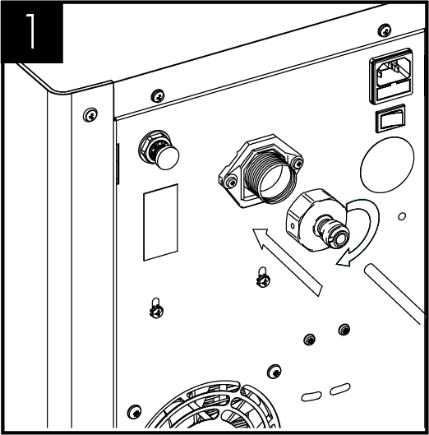
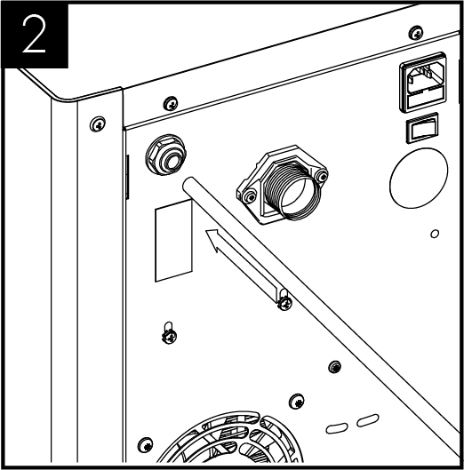
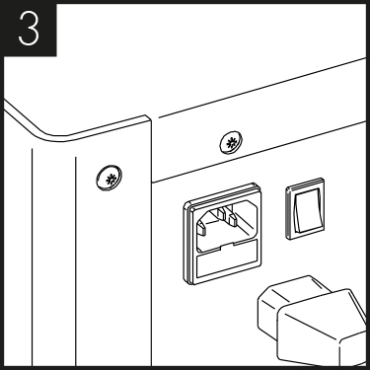
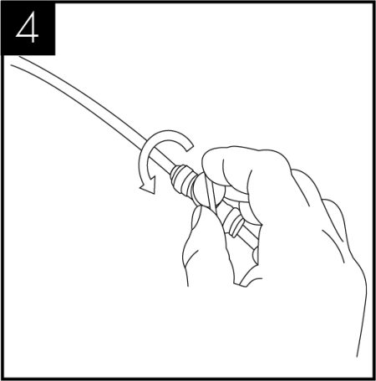
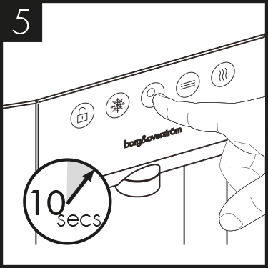
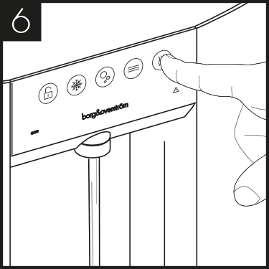
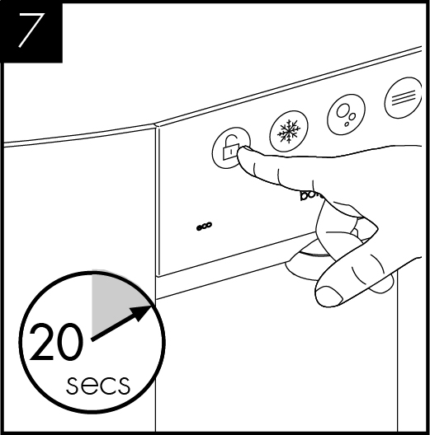
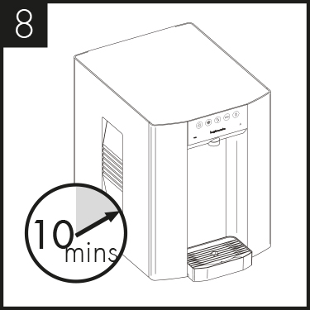
Installation
E6 Installation & Water Connection
Connect the water inlet adapter as supplied and connect to the water supply.
Connect the CO₂ supply from gas regulator, ensuring the pressure is set to max 58 PSI (4 bar), and turn on the supply (See CO₂ Installation section).
Connect the chiller to the electricity supply and ensure unit is switched on.
Turn on the water
The carbonator should be purged of air by activating the sparking water dispense for approximately 10 seconds.
The hot versions will be in commissioning mode which stops the unit from running only dispensing. With hot water versions fill the hot tank until you see water dispense.
Press the lock symbol for 10 seconds to take the unit out of commissioning mode and the LED’s and display will change.
Allow the machine to stand for 8 – 12 minutes for the initial chilling process to complete.
E6 Product Maintenance & Support | Training Deck to HMI Issue 9 & Main Control Issue 10 (HW V1.1) and Issue 12 (HW V2.1)
Issue 1 - 17062024

Slide 35
Installation
Measured Dispense - Settings
To reset/set measured amount:
Press and hold the full measured icon for ~20sec until you hear a long audible beep. The icon will then flash on and off to show you that you are setting up that dispense icon.
Press and hold the chilled icon until the desired amount is dispensed. Note: The measured icon will still flash during this dispense.
A double beep will be confirmation that this measurement is then stored in memory and will dispense the same quantity of chilled or sparkling water.
If incorrect amount is dispensed, start again.
Set back to factory default settings:
Default values have been set to 350ml and 700ml
To restore default settings, tap the chilled icon 12 times holding on the 12th until you hear a double beep, wait 2 seconds and the unit will reset.
E6 Product Maintenance & Support | Training Deck to HMI Issue 9 & Main Control Issue 10 (HW V1.1) and Issue 12 (HW V2.1)
Issue 1 - 17062024

Slide 36
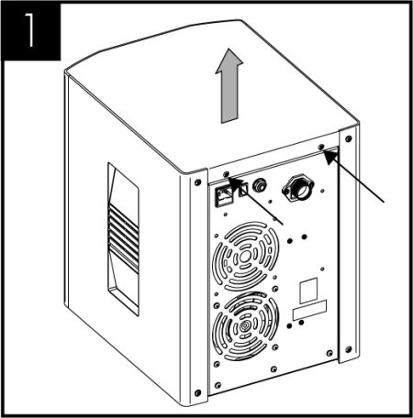
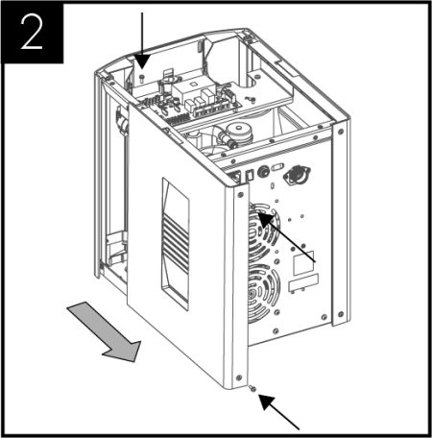
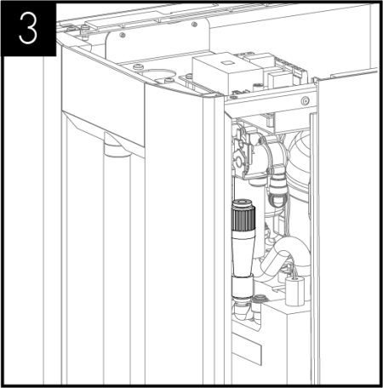
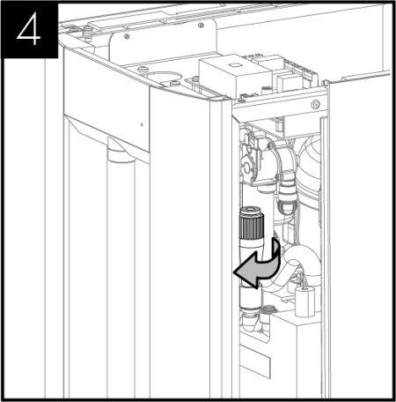
Installation
Sparkling Water Flow Rate – Sparkling Versions Only
Note: Sparkling water flow rate factory setting = 2.4L per minute MAX. This may need adjusting depending on inlet pressure. To do so follow below steps:
Remove the 2 screws holding the unit lid down and slide the lid off.
Remove the righthand side panel screws. 2 screws are located at the back and one on top. Then slide the panel back to gain access to the flow controller.
Locate the flow control adjuster, this is towards the front of the unit.
Flow can then be adjusted as follows: turning the cap anti-clockwise to increase flow and clockwise to restrict flow. After each adjustment the flow rate should be timed to an acceptable flow rate and/or uninterrupted sparkling dispense.
Once the correct flow rate is achieved place the cover back on to the unit by sliding it in place and replacing the screws.
E6 Product Maintenance & Support | Training Deck to HMI Issue 9 & Main Control Issue 10 (HW V1.1) and Issue 12 (HW V2.1)
Issue 1 - 17062024

Slide 37
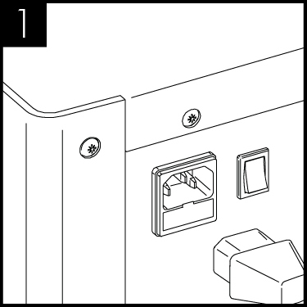
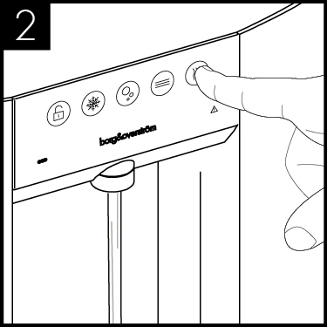

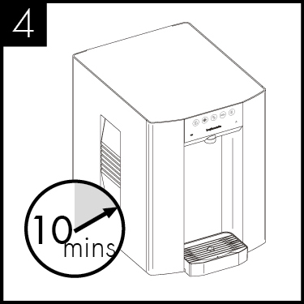
Installation
Hot Tank Commissioning
Connect the unit to the electricity supply and ensure unit is switched on.
The hot versions will be in commissioning mode which stops the unit from running only allowing dispensing. Dispense from unit to ensure tank is full.
Press the lock symbol for10 seconds to take the unit out of commissioning mode and the LED’s and display will change.
Allow the machine to stand for 10 minutes for the initial chilling and heating process to complete.
E6 Product Maintenance & Support | Training Deck to HMI Issue 9 & Main Control Issue 10 (HW V1.1) and Issue 12 (HW V2.1)
Issue 1 - 17062024

Slide 38
Thank you for your time.
Call +44 (0)1362 695 006
Email sales@borgandoverstrom.com
borgandoverstrom.com

