Slide 1
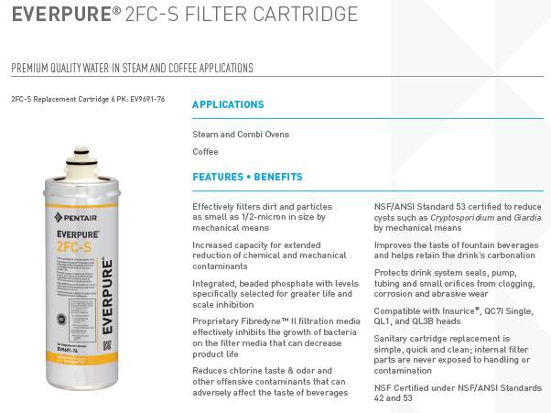
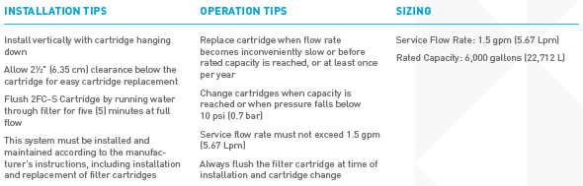
Version 5-3-2026
Pentair Water Belgium BVBA
https://www.pentair.eu/nl/product-finder/categories/coffee-machines-1349
SAP | Vendor material number | Everpure Waterfilters
55032301 | EV960100 | 4C FILTER PATROON EVERPURE COLD
55043990 | 4312-13 | FILTER EVERPURE UPPER PART QL3
55120568 | EV969176 | 2FC-S Fiberdyne filter
55120569 | EV969231 | 4FC-S Fiberdyne filter
Everpure water filters
FILTER EVERPURE UPPER PART QL3

Slide 2
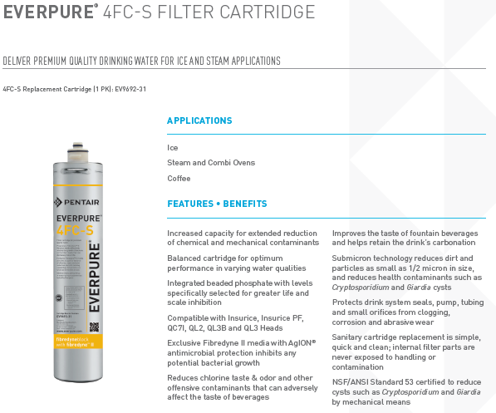
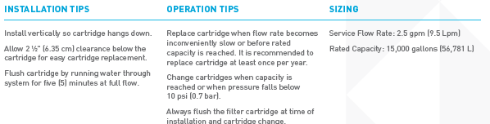
Pentair Water Belgium BVBA
SAP | Vendor material number | Everpure Waterfilters
55032301 | EV960100 | 4C FILTER PATROON EVERPURE COLD
55043990 | 4312-13 | FILTER EVERPURE UPPER PART QL3
55120568 | EV969176 | 2FC-S Fiberdyne filter
55120569 | EV969231 | 4FC-S Fiberdyne filter
Everpure water filters
FILTER EVERPURE UPPER PART QL3

Slide 3

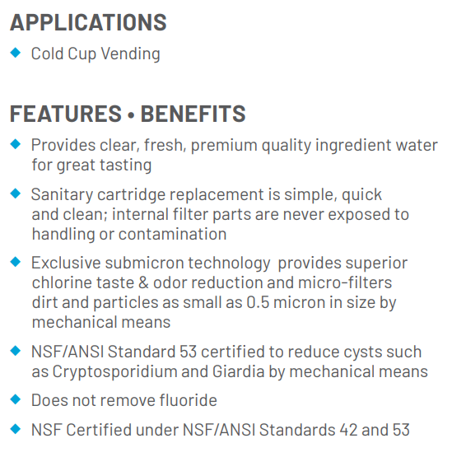
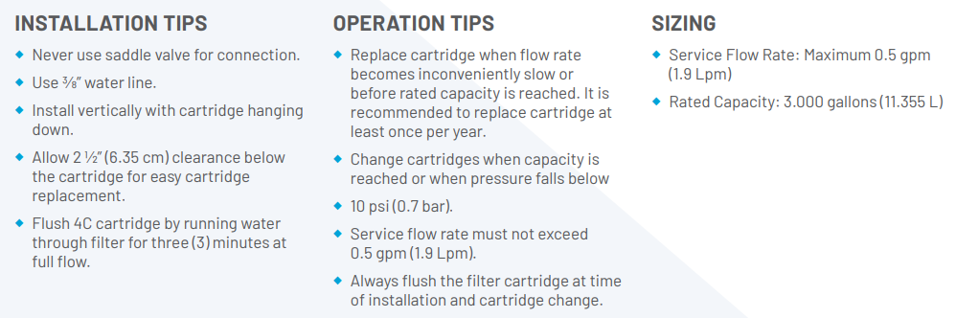
Pentair Water Belgium BVBA
SAP | Vendor material number | Everpure Waterfilters
55032301 | EV960100 | 4C FILTER PATROON EVERPURE COLD
55043990 | 4312-13 | FILTER EVERPURE UPPER PART QL3
55120568 | EV969176 | 2FC-S Fiberdyne filter
55120569 | EV969231 | 4FC-S Fiberdyne filter
Everpure water filters
FILTER EVERPURE UPPER PART QL3

Slide 4

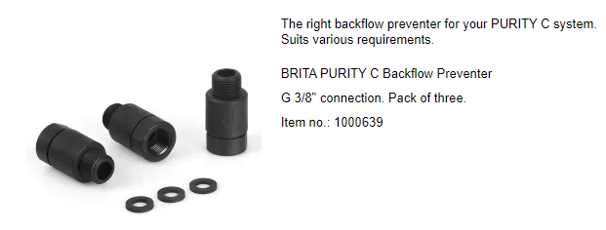
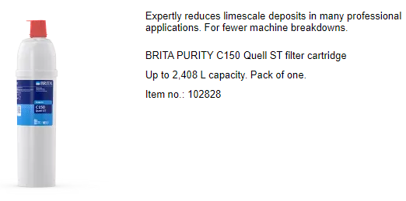
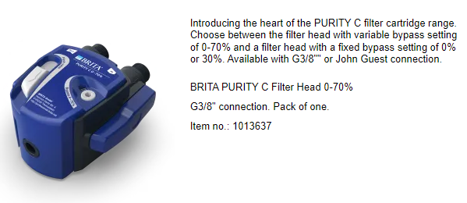
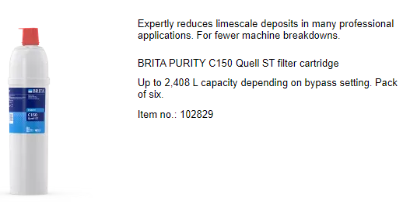
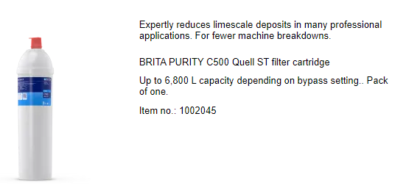
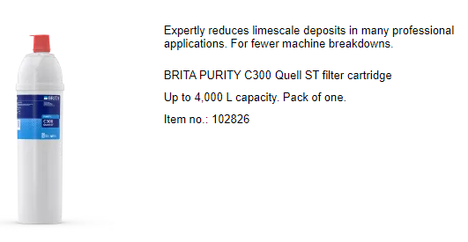
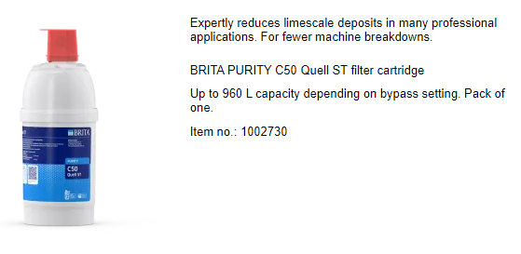
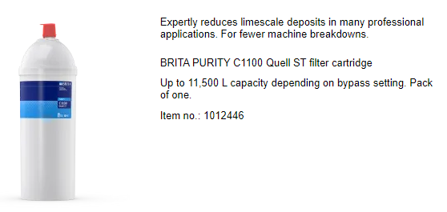
http://www.brita.co.uk/brita/en-gb/cms/professional.grid
SAPnr. | Description | Vendor Material number
55111738 | PURITY C RÜCKFLUßVERHINDERER G3/8 | 1000639
55113842 | PURITY C HEAD 0-70% G3/8" (PACK 1) | 1013637
55111739 | PURITY C500 QUELL KARTUSCHE BRITA | 1002045
55112461 | PURITY C50 QUELL FI | 1002730
SAPnr. | Description | Vendor Material number
55113844 | PURITY C150 QUELL ST (PACK 1) | 102828
55113845 | PURITY C150 QUELL ST (PACK 6) | 102829
55115867 | PURITY C300 QUELL ST | 102826
55115868 | PURITY C1100 QUELL ST | 1012446

Slide 5
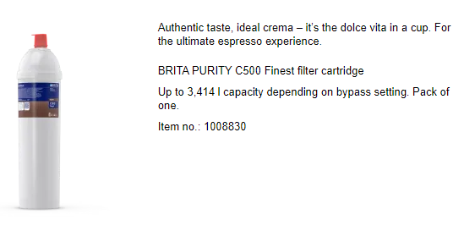
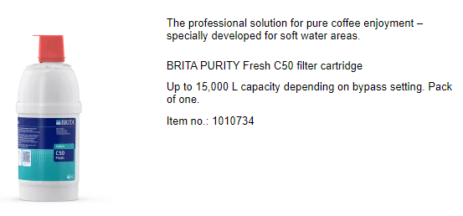
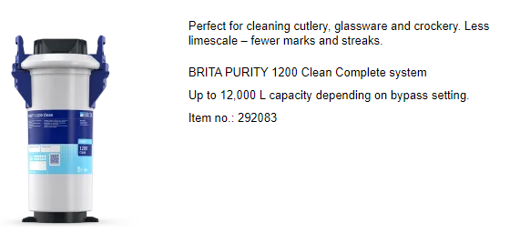
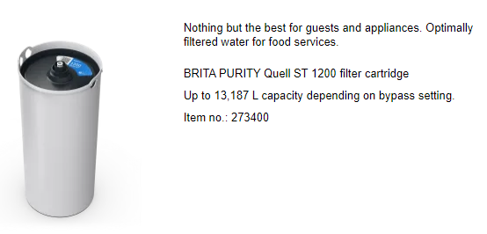
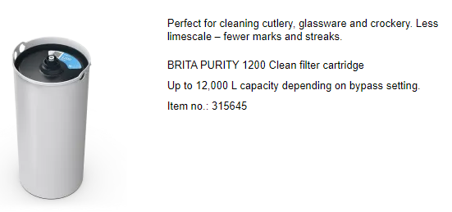
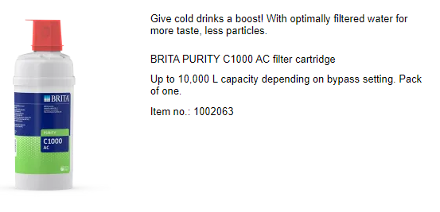
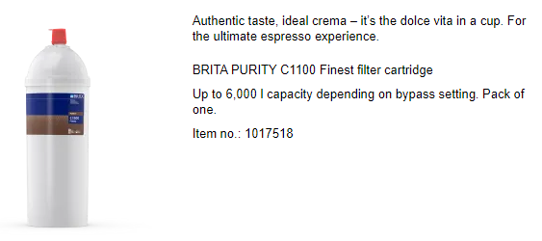
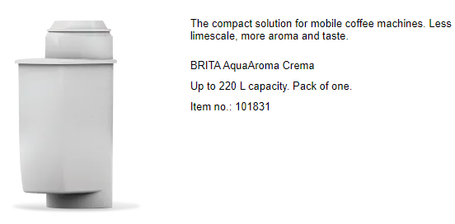
SAPnr. | Description | Vendor Material number
55115869 | PURITY C500 FINEST | 1008830
55115871 | PURITY 1200 CLEAN HW NEW | 292083
55115902 | PURITY 1200 CLEAN FILTER | 315645
55116440 | PURITY C1100 FINEST | 1017518
SAPnr. | Description | Vendor Material number
55118293 | PURITY FRESH C50 WATERFILTER | 1010734
55119690 | BRITA FIKA PURITY 1200 QUELL ST | 273400
55119692 | BRITA PACK 1 PURITY C1000 AC CU | 1002063
55124071 4061281 | BRITA AQUA AROMA CREMA | 101831

Slide 6
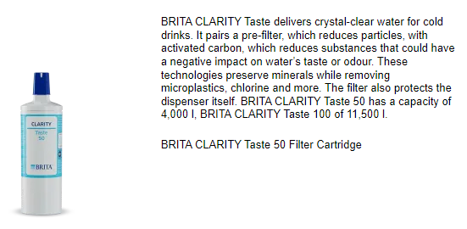
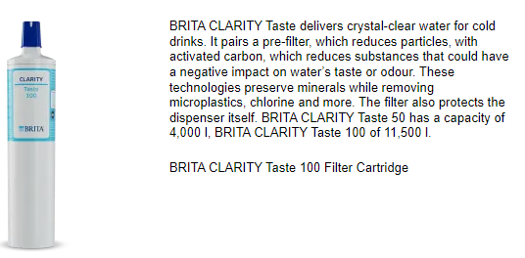
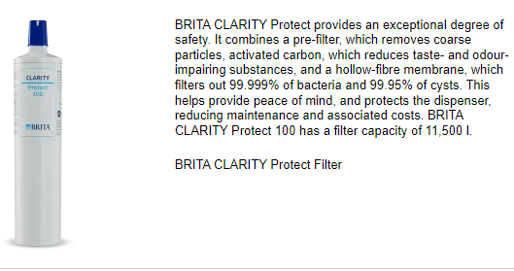
For Brita and B&O water dispensers
SAPnr. | Description | Vendor Material number
55122313 | CLARITY SERVICE CARTRIDGE needed for flushing with descaler | 1020917
55122699 | CLARITY TASTE 50 FILTER CARTRIDGE max. half year | 1020509
55122700 | CLARITY TASTE 100 FILTER CARTRIDGE max. half year | 1020569
55122701 | CLARITY PROTECT 100 FILTER CARTRID max. year | 1020581
55122702 | CLARITY FILTER HEAD | 1024792

Slide 7

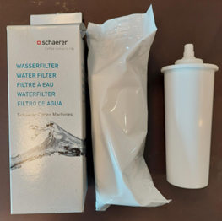
FILTER 200 REPL. CARTRIDGE 4-PC. SET for Schaerer Coffee Club
SAPnr. | Description | Vendor Material number
55109297 4058058 | FILTER 200 REPL. CARTRIDGE 4-PC. SET SCHAE 1PCX1 WATERFILTER CARTRIDGE 4-PC | 071397 | A box with 4 of these

Slide 8
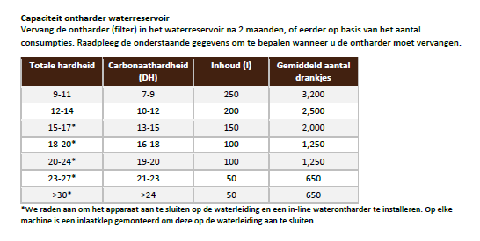
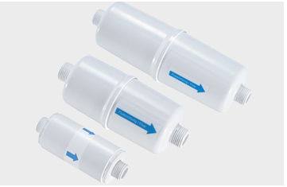
Aquis for L’OR SUPRÊME
551242344061434 | Aquis CLARIS - CS 150 | 1001132
Aqua free for Cafitesse hot&cold
55124976 | INLINE FILTER IL5 | 102379
55124977 | INLINE FILTER IL3 | 101002
Vendor
material
Sapnr. Description number
https://aclaris.com/en/in-tank-filter-acl-tfb150/
Vendor
material
Sapnr. Description number
https://www.aqua-free.com/nl/zoeken?tx_solr%5Bq%5D=il5

Slide 9

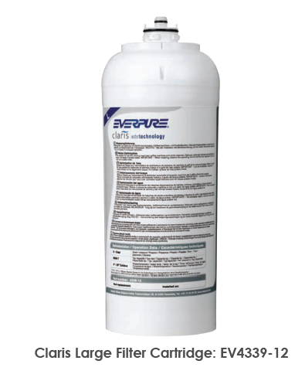
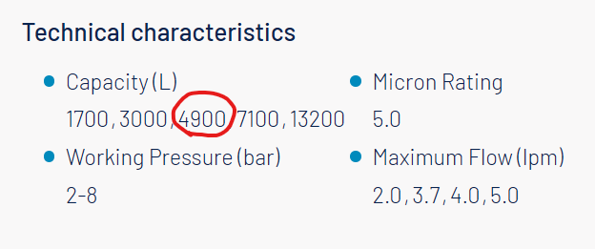
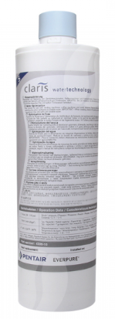
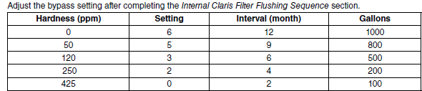
CLARIS HARDNESS REMOVAL FILTRATION
SAPnr. | Description | Vendor Material number
55126040 | CLARIS HARDNESS REMOVAL FILTRATION | 00986059
55127681 | Replacement Claris Filter Cartridge | 01548635

Slide 10

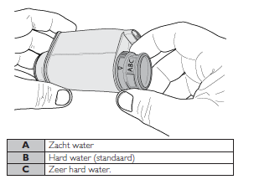
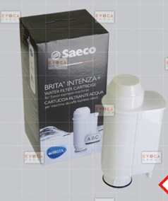
Brita water filter Intenza (only for watertank version needed for Magic)
SAPnr. | Description | Vendor Material number
55126399 4057069 | BRITA WATER FILTER 1 UNIT SAECO BRITA WATER FILTER INTENZA | 21002660

