Slide 1
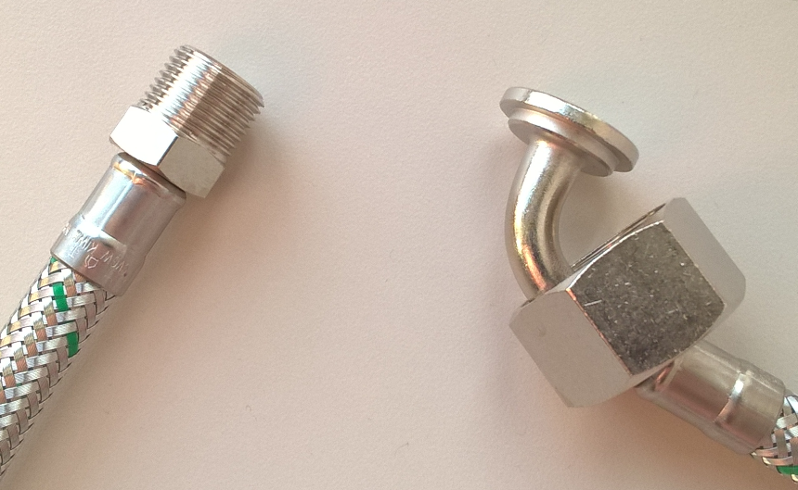
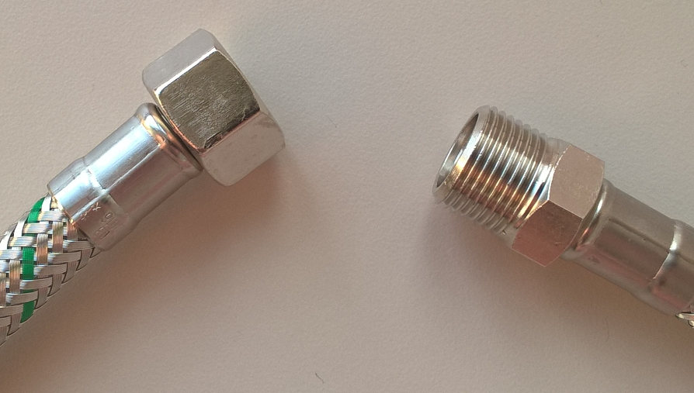
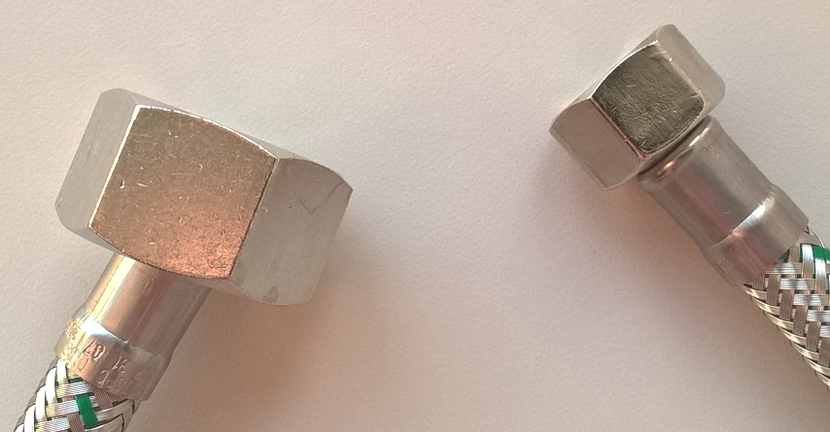
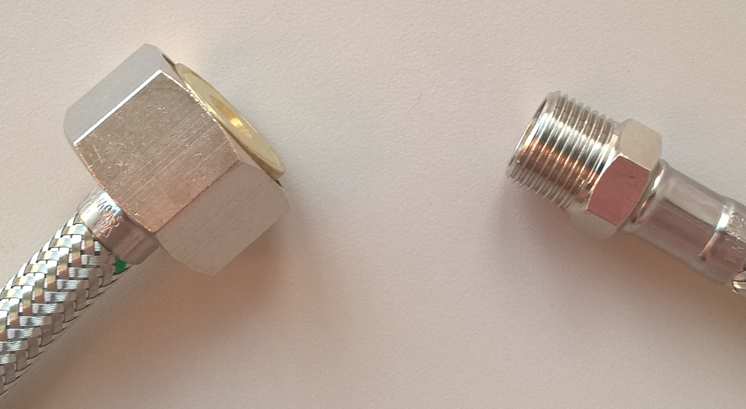
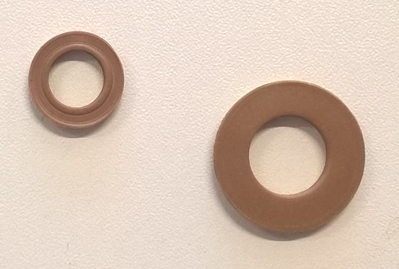
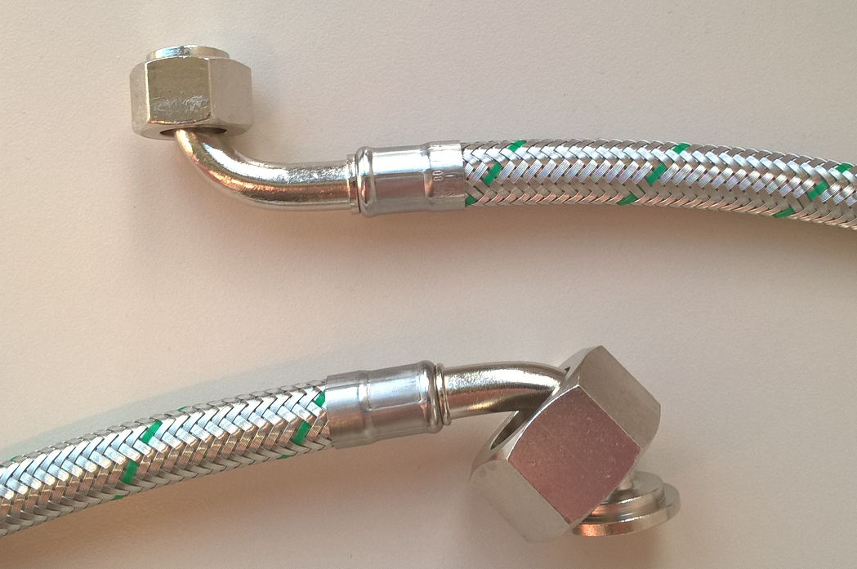
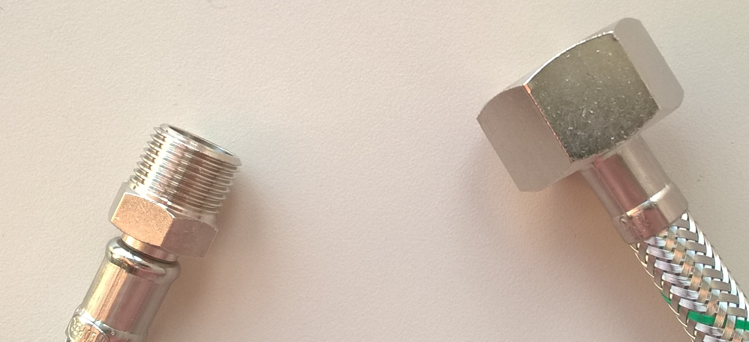
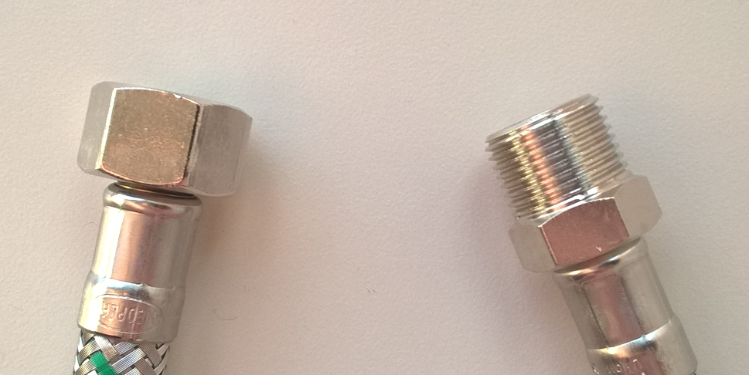
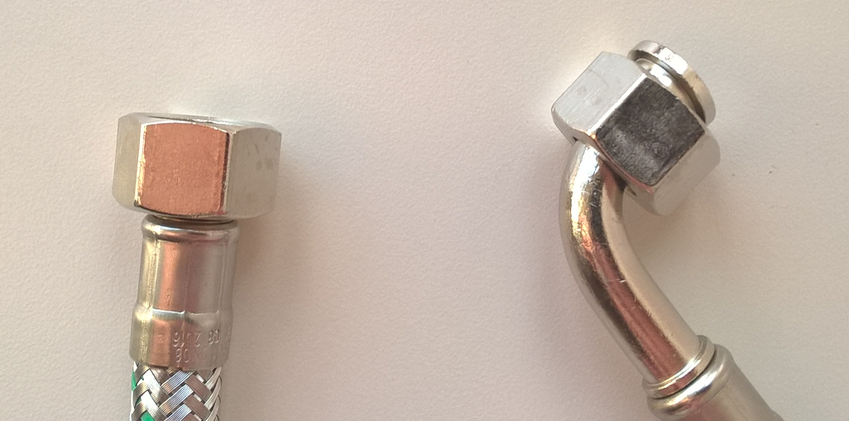
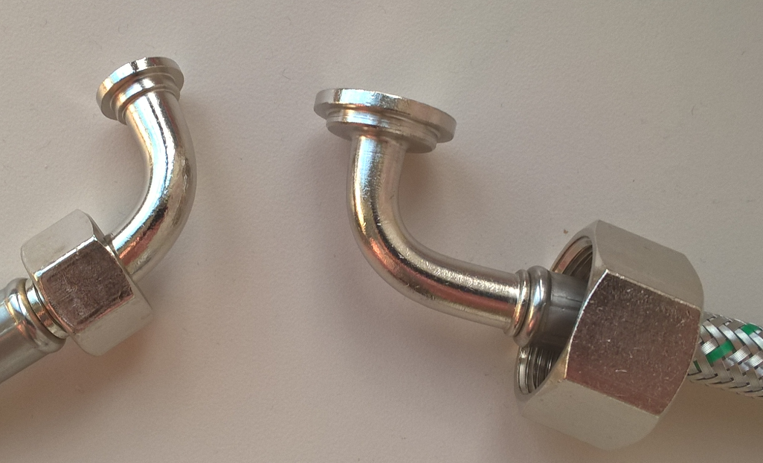
SAP | Stainless steel hoses
55042591 | SPX241 DN08 3/8 MR X 3/4SF 1000MM
55042590 | SPX241 DN08 3/8MR X 3/4E 1000MM
55042588 | SPX241 DN08 3/8F X 3/8MR 500MM
55000510 | SPX241 DN08 3/4E X 3/8E 500MM
55042587 | SPX241 DN08 3/8F X 3/8MR 1000MM
55115942 | SPX241 DN08 3/8F x 3/4E 700 MM
55115943 | SPX241 DN08 3/8M x 3/4E 700 MM
55115941 | SPX241 DN08 3/8E x 3/4E 1500 MM
55102010 | SPX241 DN08 3/4E X 3/8E 2500MM
Stainless steel hoses & Gaskets
version 06-10-2022
SAP | Gaskets
55041506 | Aquarubber 15 x 9,5 x 2,5mm (3/8)
55042595 | Aquarubber 24 x 13 x 3mm (3/4)
55042590
55042588
55115942
55115943
55102010
55042591
55042587
55000510
55115941
Neoperl stainless steel hoses with an inner core of Softpex are taste neutral.

